Slide 1
Capability Capsule 能力胶囊
Flexible in form, strict in verification and quality assurance. A schema built onto openJiuwen
Muk Chunpongtong
Notes:
TIME 0:30
SAY: - The thesis in one line: flexible in form, strict in verification and quality assurance
- Flexibility makes adoption cheap; strictness makes flexibility safe
- Three questions, in order: what is in a capsule, what are its mechanisms, what fits inside one

Slide 2
THE ASSIGNMENT
The key slides ◆ jump between these
# |  | Requirement | The slide that answers it
3 | a | Function | Why AI4Research needs this
4 | b | Architecture | The whole shape
6 |  | The ask | The schema is the deliverable
9 |  | Verification, RSI | What verification and RSI get
14 | c | Position | Every stage applies capabilities
16 | g | Feasibility | What CC does not build
17 | f | Advantages | Overlap and merge
19 | e | Similar designs | Inspiration from other software
20 | d | Dependencies | Impacts across the workflow
26 |  | Close | What would prove this wrong
merged/REPORT.md §2
2
Notes:
TIME 1:00
SAY: - Nine slides carry the argument, and they are marked with a diamond
- Jumping between them answers every letter, so the deck can be cut live
- Everything else supports one of the nine

Slide 3
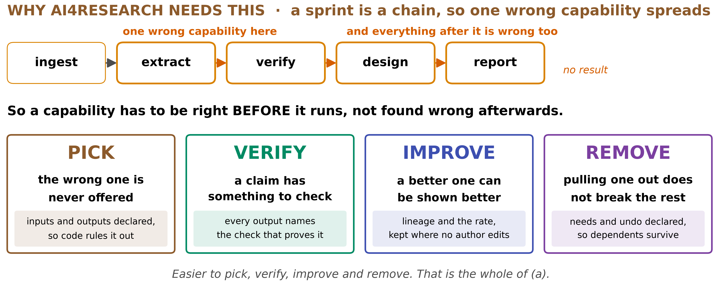
◆ A · FUNCTION
Why AI4Research needs this
A sprint is a chain. A capability has to be right before it runs
merged/REPORT.md §2a
3
Notes:
TIME 2:00
SAY: - A research sprint is a chain, so a wrong capability early poisons every stage after it
- Four verbs, each bought by a declared field, not by a convention
- PICK: inputs and outputs are declared, so code rules out what cannot fit, before a model ranks anything
- VERIFY: every output names the check that proves it, so a claim always has a target
- IMPROVE: lineage and a success rate are kept where no author can edit them, so better is demonstrable
- REMOVE: needs and undo are declared, so pulling one out does not silently break its dependents
- The whole of requirement a is those four verbs getting cheaper

Slide 4
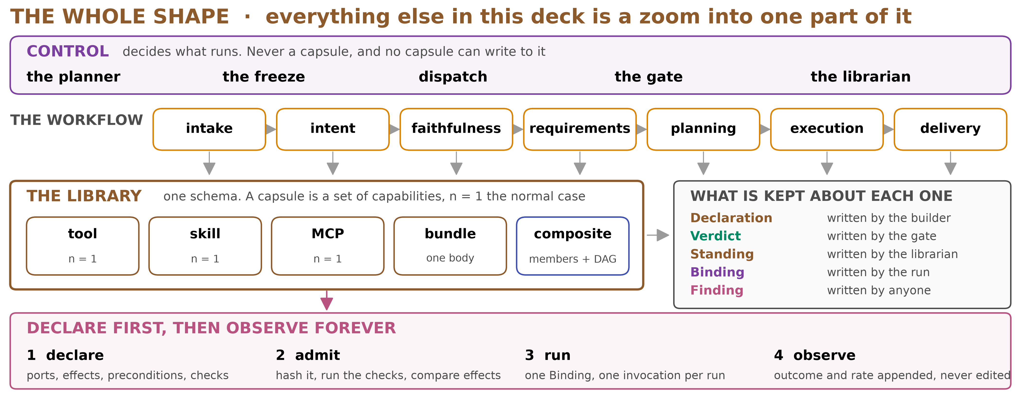
◆ B · STRUCTURE
The whole shape
Everything after this is a zoom into one part of it
merged/SCHEMA.md §1
4
Notes:
TIME 2:00
SAY: - Three bands: control above, the library below it, and the records kept about every capsule
- Control is the planner, the freeze, dispatch, the gate and the librarian. None is ever a capsule, and no capsule may write to them
- The library holds one schema for every shape: a tool, a skill, an MCP server, a bundle, a composite
- Each capsule accumulates five records: a Declaration written by the builder, a Verdict from the gate, a Standing kept by the librarian, a Binding per run, and a Finding from anyone
- The loop underneath is declare, admit, run, observe. Declaration is written once, observation never stops
- Everything later in the deck is a zoom into one band

Slide 5
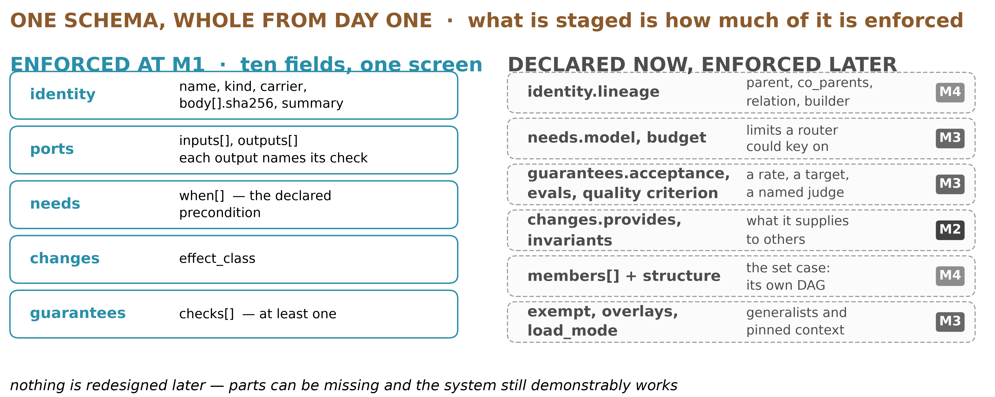
B · STRUCTURE
What is in a 能力胶囊
Ten fields at M1. The rest is declared now, inert until used
merged/SCHEMA.md §3.1
5
Notes:
TIME 2:00
SAY: - Ten fields are enforced at M1, and this is all of them
- identity.name is a stable readable name, and it is allowed to move, because the gate binds the hash and not the name
- identity.kind is tool, mcp, skill, prompt, subagent, agent or composite, and it picks the carrier
- identity.carrier is the agent-core class that loads it unchanged: ToolCard, SkillSpec, McpServerSpec, PluginSpec, AgentTemplateSpec. CC adds no loader of its own
- identity.body is every file with its SHA-256. That hash is over the files that run, so the thing checked is the thing that ran, and a mismatch at load aborts the load
- identity.summary is what a model reads when choosing. It reads the summary and the ports, never the body
- ports.inputs and ports.outputs carry a name and a type, and every output names the check that proves it
- needs.when is the precondition: a check, a path, an operator, and when it can be evaluated. One shared evaluator runs it at planning and again at dispatch on fresh state
- changes.effect_class is what it does to the world, and the gate compares observed effects against it
- guarantees.checks is at least one check, and a capsule with none cannot be admitted

Slide 6
◆ B · STRUCTURE
The schema is the deliverable
File | What it is | Why separate
capsule.schema.json | JSON Schema 2020-12 for the Declaration: every field, type and enum | SHAPE. Marks almost nothing required, so tools that code against it keep compiling
policy-m1.json | What the M1 epoch insists on, applied alongside the shape | GATE. Versioned and relaxable, and every Verdict records the epoch that admitted under it
validate_capsule.py | Validates a Declaration against either, or both | So the gate is runnable, not described
examples/ | A real capability, the same one as declared today, and a composite | The one declared today is REJECTED by the gate, and it prints why
A required field in a shared schema can never be taken back, so Protocol Buffers removed required. Shape stays stable, enforcement moves to a policy that can tighten or relax
merged/capsule.schema.json, policy-m1.json, validate_capsule.py, examples/
6
Notes:
TIME 1:40
SAY: - The artifact is machine-readable and it is the thing to agree on today
- capsule.schema.json is shape only, and it marks almost nothing required
- policy-m1.json is the enforcement profile, and it holds the required-ness for this epoch
- The split is deliberate. A required field in a shared schema can never be taken back, which is why Protocol Buffers removed required and tells authors to document it instead
- So the shape stays stable and the policy tightens, epoch by epoch, and every Verdict records the epoch that admitted under it
- Three examples ship with it, including one that the gate correctly rejects

Slide 7
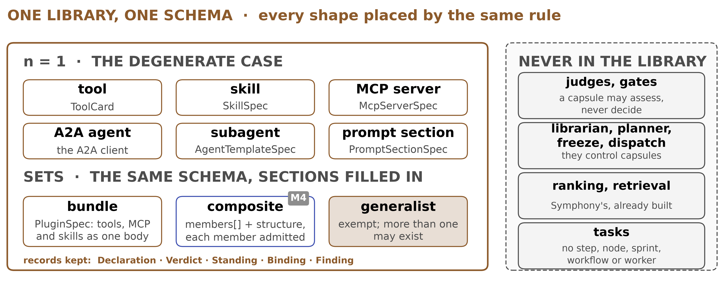
B · STRUCTURE
One library, one schema: what a capsule can be
A capsule holds a set of capabilities. n = 1 is the normal case
merged/SCHEMA.md §0.2, §4.10
7
Notes:
TIME 1:10
SAY: - One schema covers every shape, because the shape is carried by the carrier, not by a second format
- A capsule holds a set of capabilities. n equals one is the degenerate case and simply omits members
- A composite names its members by role and pins each by decl_hash, so internals cannot move under it
- wiring connects ports. An endpoint is role dot port for a member, or inputs dot port and outputs dot port for the composite boundary, which is how one capsule goes inside another without being rewritten
- structure is the order they run in, in the shape symphony flow already uses for a recipe
- Because a member is named only by its hash, a member may itself be a composite, so nesting needs no extra field
- Never in the library: judges and gates, the control components, ranking and retrieval, and tasks

Slide 8
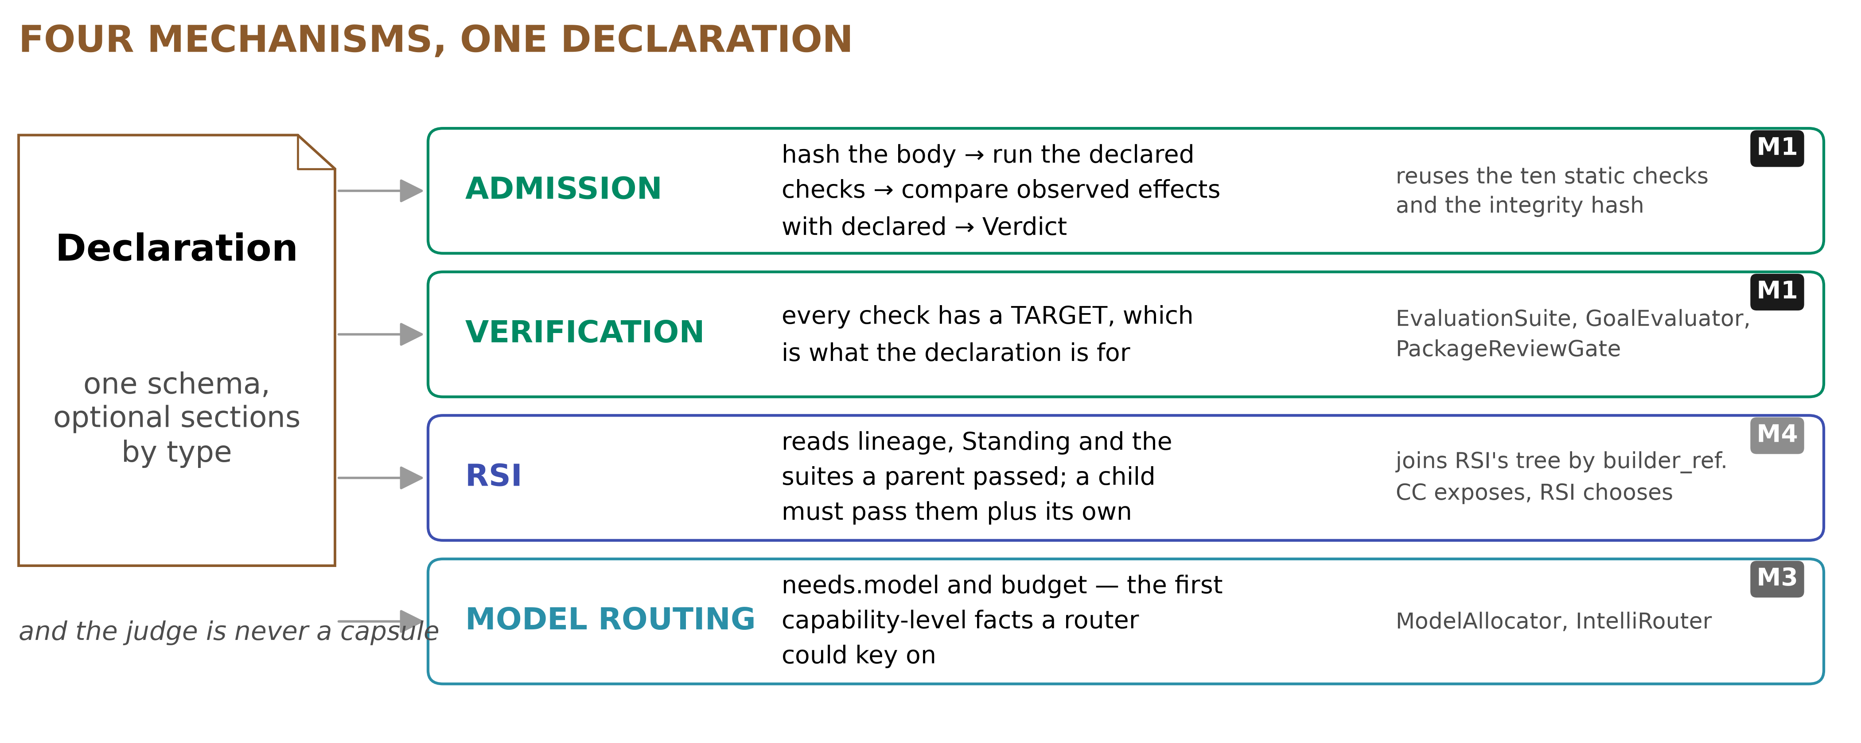
B · MECHANISMS
Four mechanisms, one Declaration
CC stores and exposes. RSI chooses, and CC never sets its policy
merged/SCHEMA.md §4.1, §4.13a
8
Notes:
TIME 1:10
SAY: - Four mechanisms read the same Declaration, and none of them needs a field of its own
- Admission hashes the body, runs the declared checks, compares observed effects with declared, and writes a Verdict. It reuses the ten static checks already in symphony flow
- Verification works because every check has a target, which is what declaring ports is for
- RSI reads lineage, the Standing and the suites a parent passed. A child must pass those plus its own
- Model routing reads needs.model and budget, the first capability-level facts a router could key on
- The judge is never a capsule, and that is the line that keeps this honest

Slide 9
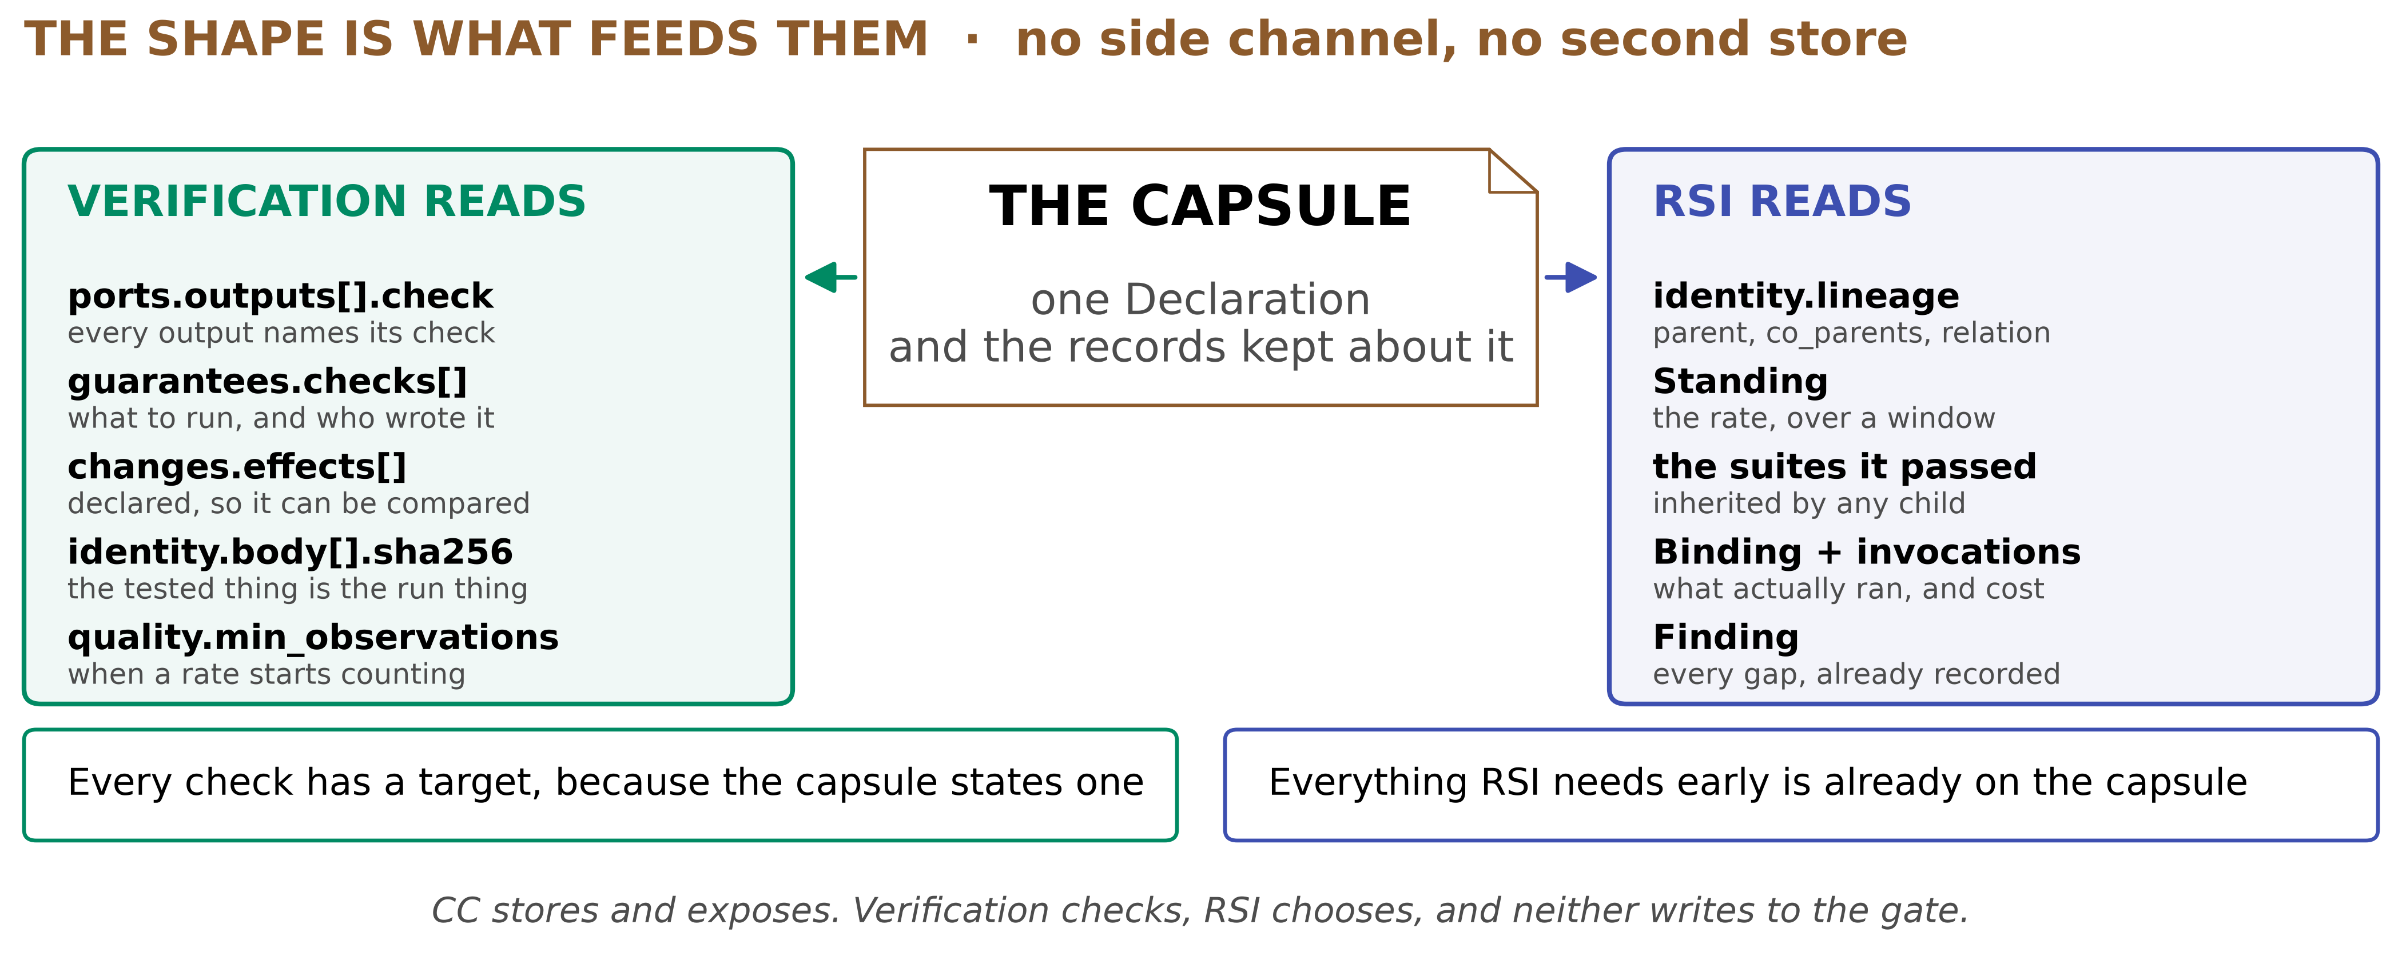
◆ B · MECHANISMS
What verification gets, and what RSI gets
No side channel. Everything RSI needs early is already on the capsule
merged/REPORT.md §10
9
Notes:
TIME 1:40
SAY: - Neither team needs a side channel, a second store, or a format of its own
- Verification reads ports.outputs check, so every claim has a target. It reads guarantees.checks for what to run and who wrote it, changes.effects to compare declared against observed, and identity.body sha256 to know the tested thing is the run thing
- RSI reads identity.lineage for parent, co_parents and relation, the Standing for the rate over a window, the suites a parent passed, which a child inherits, the Binding and its invocations for what actually ran and what it cost, and every Finding
- The division is exact. CC stores and exposes, verification checks, RSI chooses, and neither writes to the gate

Slide 10
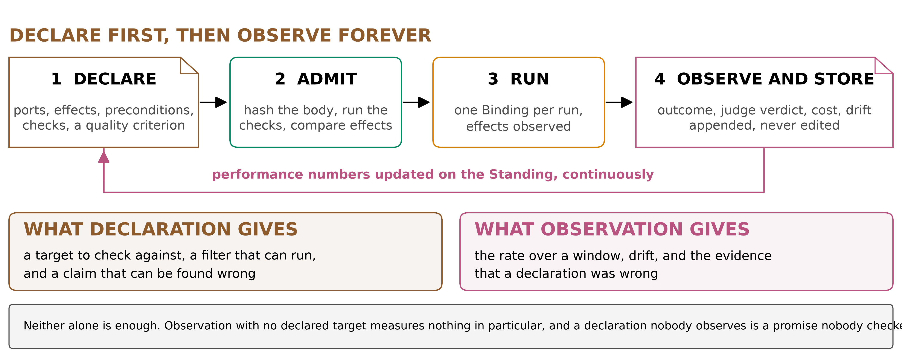
F · QUALITY
Declare first, then observe forever
Neither alone is enough, and neither of them comes second
merged/SCHEMA.md §4.5c, §3.3
10
Notes:
TIME 1:40
SAY: - Declaration and observation are not alternatives, and neither one comes second
- Declare gives a target to check against, a filter that can run before a model is asked, and a claim that can be found wrong
- Admit hashes the body, runs the checks and compares effects, once
- Run produces one Binding per run, with the effects observed
- Observe appends outcome, judge verdict, cost and drift to the Standing, and never edits what is there
- Observation with no declared target measures nothing in particular, and a declaration nobody observes is a promise nobody checked

Slide 11
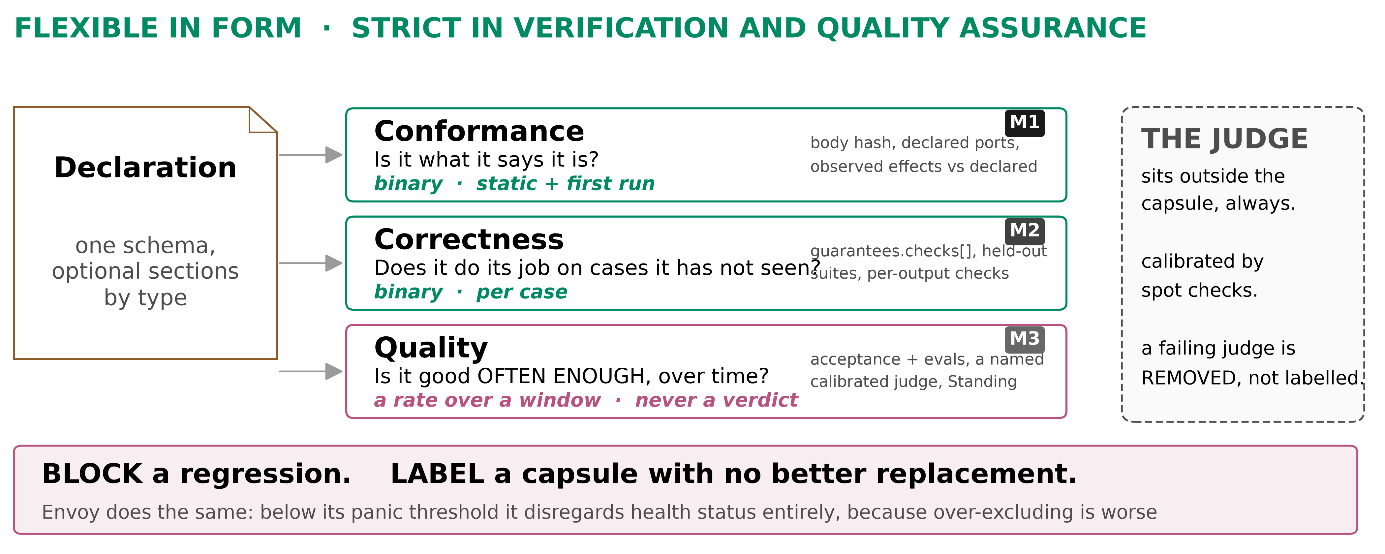
F · QUALITY
Quality is not correctness
Correctness is binary. Quality is a rate over a window
merged/SCHEMA.md §4.5c
11
Notes:
TIME 1:30
SAY: - Three layers, and they are different in kind, not in strictness
- Conformance asks whether it is what it says it is. Binary, from the body hash, the declared ports and observed effects against declared ones
- Correctness asks whether it does its job on cases it has not seen. Binary, per case, from guarantees.checks and held-out suites
- Quality asks whether it is good often enough over time. That is a rate over a window, never a verdict, from acceptance and evals, a named calibrated judge, and the Standing
- The rule that follows: block for safety, label for quality. A quality number blocks nothing until a declared minimum number of observations has been reached

Slide 12
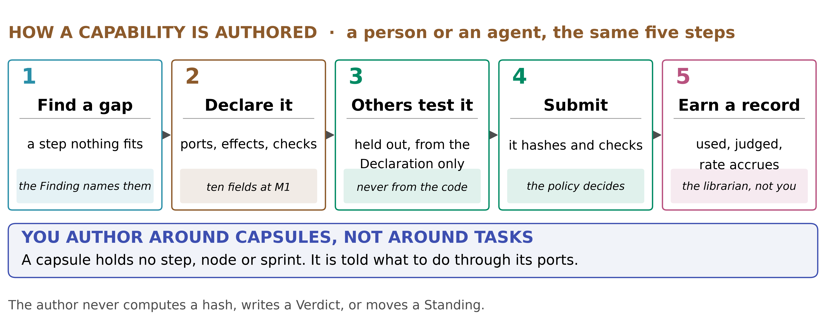
B · MECHANISMS
How a capability is authored
Author around capsules, not around tasks. A capsule holds no step
merged/SCHEMA.md §4.12, §0.6
12
Notes:
TIME 1:40
SAY: - The same five steps whether a person or an agent does the authoring
- Find a gap, and the Finding names it
- Declare before building, which is what binds a suite to a contract. contract_hash is taken over every section except the body and the lineage, so a suite written first stays valid, and a body submitted against a different contract makes that suite void
- Write the checks, then the body, then submit to the gate
- The point for the room: authoring is around capsules, not around tasks. A capsule holds no step, no node and no sprint

Slide 13
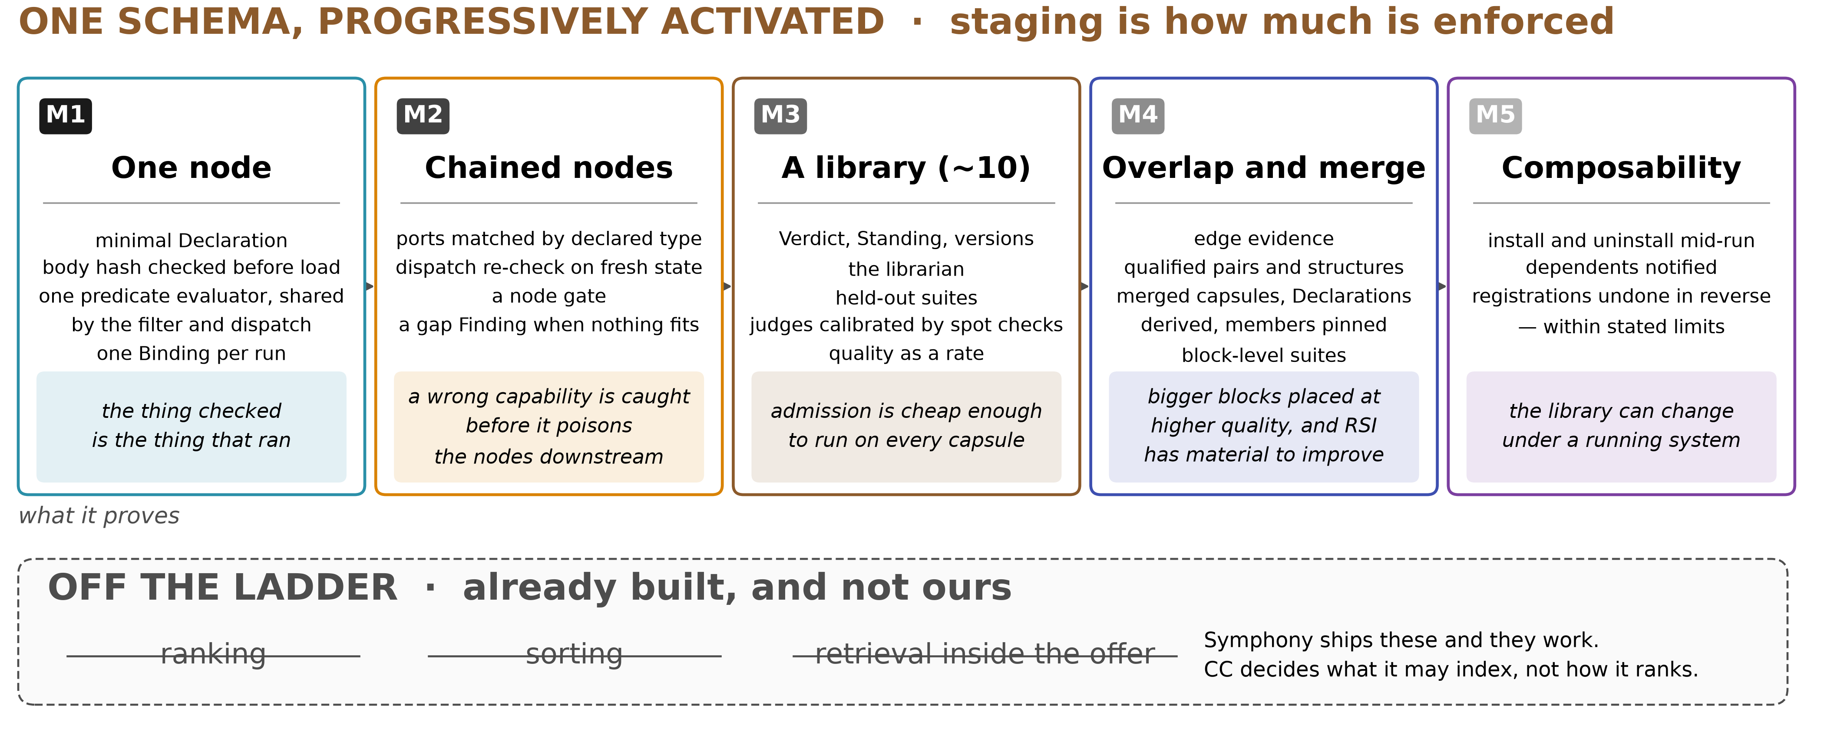
G · FEASIBILITY
What is needed when
M1 is one node. Composability is last, not first
merged/SCHEMA.md §0.7
13
Notes:
TIME 1:20
SAY: - The schema is whole from day one, and what is staged is how much of it is enforced
- M1 is one node: the ten fields, the hash check before load, one shared predicate evaluator, one Binding per run
- M2 adds chained nodes, so ports are matched by declared type and a gap Finding is written when nothing fits
- M3 adds a library of about ten, the Verdict and Standing records, held-out suites and quality as a rate
- M4 adds overlap and merge, lineage and members
- M5 adds composability, which is install and uninstall under a running system
- A field is declared from the start and sits inert until the thing that reads it exists, so nothing is redesigned later

Slide 14
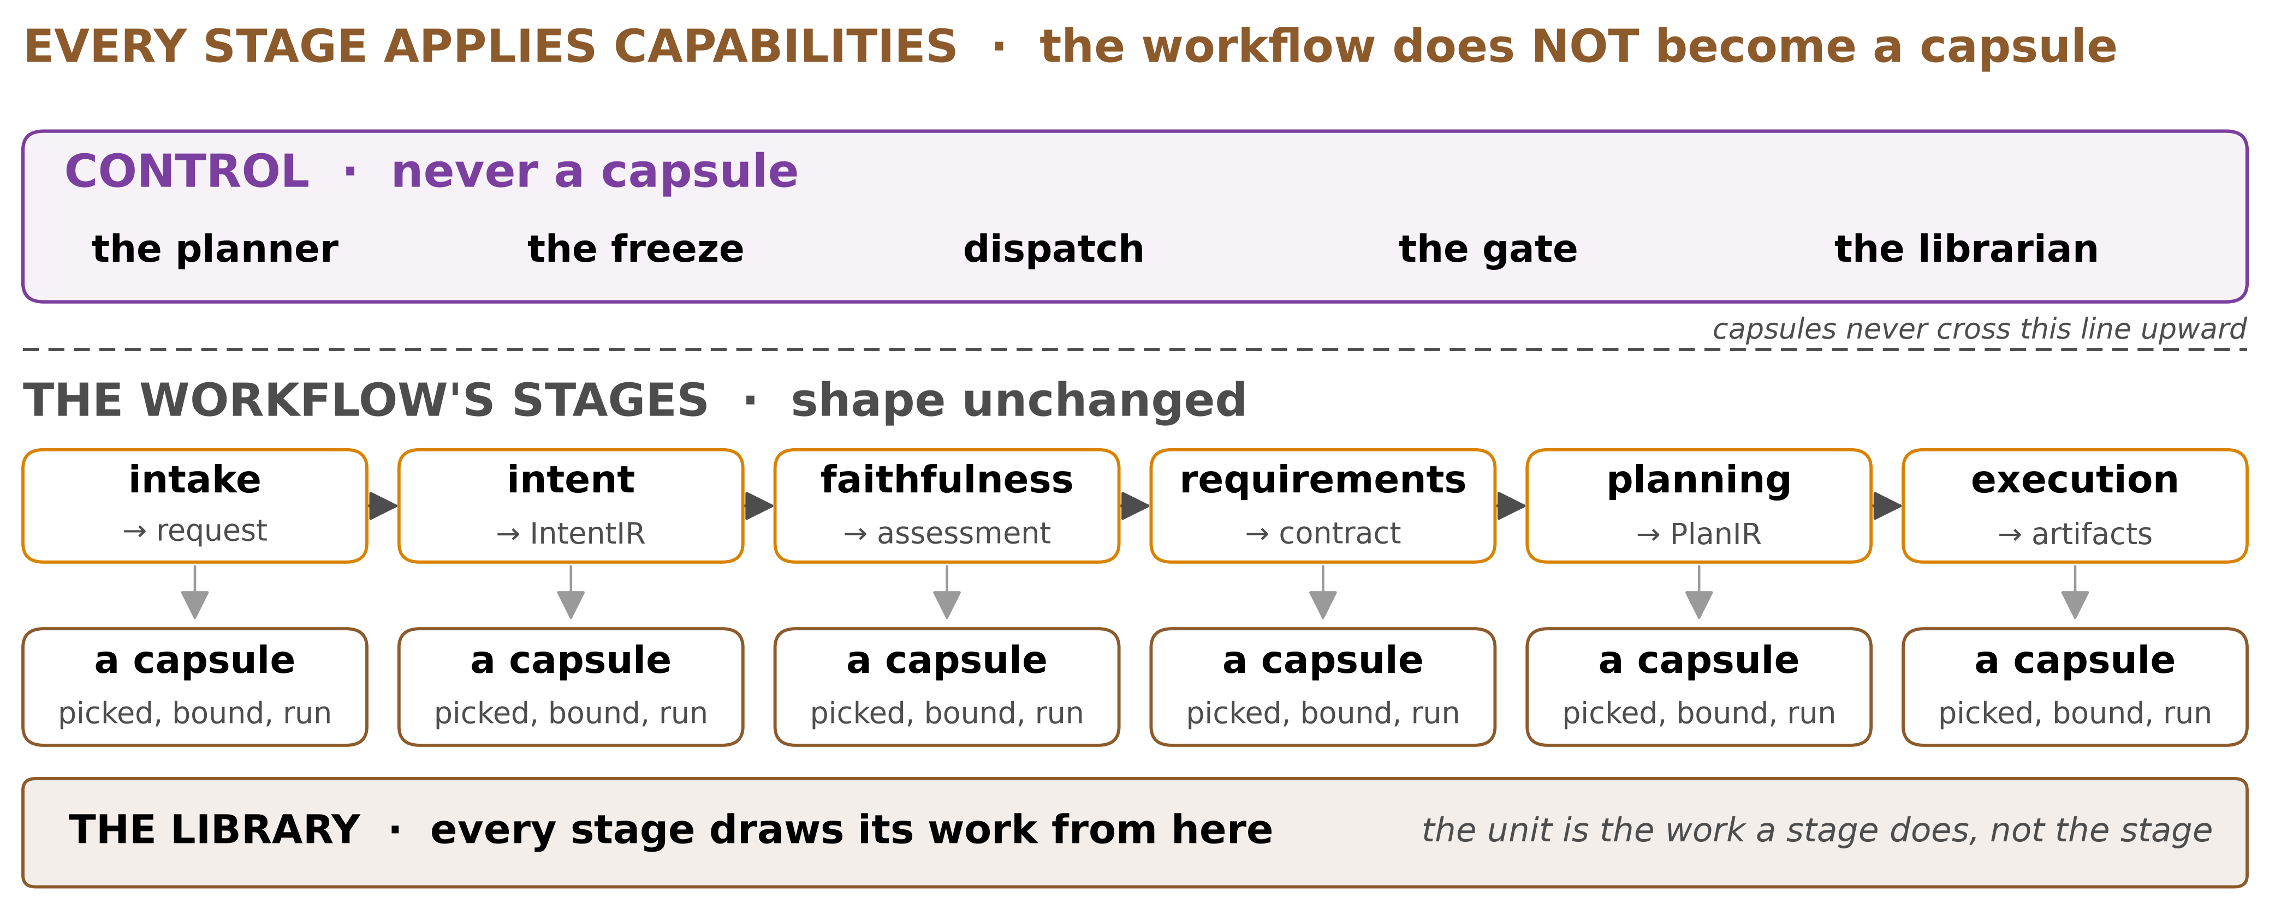
◆ C · POSITION
Every stage applies capabilities
The workflow is never a capsule. The unit is a stage's work
merged/SCHEMA.md §0.5. AI4Research b0bf165f9, read in source
14
Notes:
TIME 1:30
SAY: - The unit is the work a stage does, not the stage itself
- Intake, intent, faithfulness, requirements, planning, execution and delivery each draw their work from the library
- The workflow does not become a capsule, and that distinction matters. What is never a capsule is anything that decides
- A capsule may produce an assessment. It may never be the thing that acts on one
- That is enforced by the existing protected-components rule on write access, not by trying to classify what an author intended

Slide 15

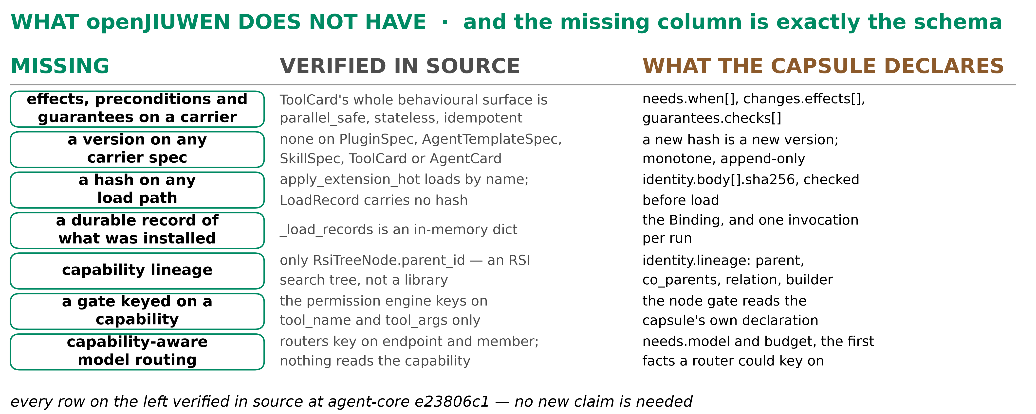
F · WHY CC
What openJiuwen does not have
Seven absences, verified in source. The missing column is the schema
↗ kubernetes.io admission control
agent-core e23806c1, read in source
15
Notes:
TIME 1:30
SAY: - Seven absences, each verified in source rather than assumed
- There is no declaration on the block, no lineage, no held-out test, and members are not pinned by hash
- The missing column is the schema. The engine is largely there
- Admission control as a named stage is the pattern here, and Kubernetes has run it for years: requests are intercepted before the resource is persisted, after authentication and authorisation, and one rejection rejects the whole request

Slide 16
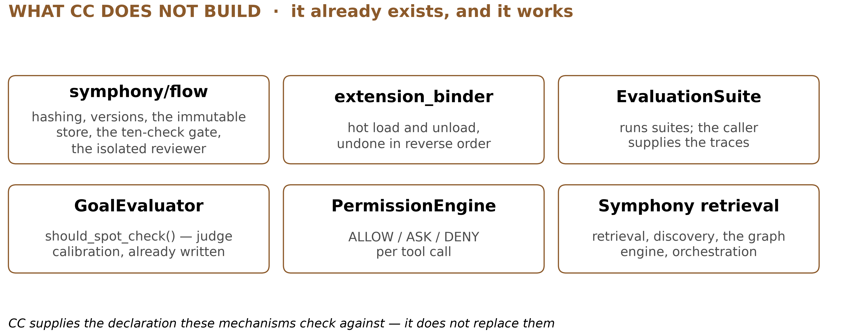
◆ G · FEASIBILITY
What CC does not build
symphony/flow already has the store, the versions and the gate
agent-core e23806c1, read in source
16
Notes:
TIME 1:10
SAY: - Feasibility rests on how little is new
- symphony flow already implements the store, the content identity, immutable versions, a ten-check gate and a reviewer
- Ranking, sorting and retrieval inside the offer are Symphony's, they work, and CC does not touch them
- CC decides what Symphony may index, not how it ranks
- What is genuinely new is the schema and the records hung off it

Slide 17

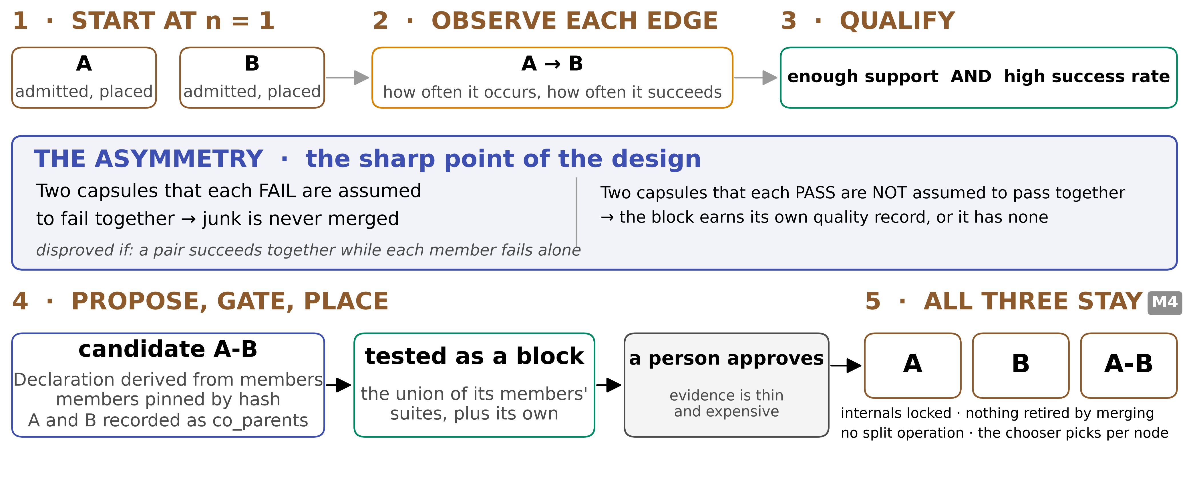
◆ F · MERGE
Overlap and merge
Failing parts never merge. Passing parts do not make a passing block
↗ docs.aws.amazon.com automated materialized views
merged/SCHEMA.md §4.9a
17
Notes:
TIME 2:00
SAY: - Everything starts at n equals one, then every edge is observed for how often it occurs and how often it succeeds
- An edge qualifies on enough support and a high success rate, counted in sprints rather than nodes
- The asymmetry is the sharp point. Two capsules that each fail are assumed to fail together, so junk never merges. Two that each pass are not assumed to pass together, so the block earns its own quality record or it has none
- A candidate derives its Declaration from its members, pins them by hash, and records both as co_parents
- A, B and A-B all remain. Internals are locked, nothing is retired by merging, and there is no split
- Redshift does the same trade, creating a materialized view from recurrence and gating it on expected benefit against the cost to maintain it

Slide 18
F · MERGE
What happens to A-B when A becomes A′
Question | Answer | Where this is already done
Does A-B break? | No. It pinned A by hash and keeps running on it | Amazon: a new child version does not change a parent until its reference moves
Does A-B become A′-B? | Never. Internals are locked, so a member change is a new block, not an edit | Google Bazel: change an input's checksum and the cached output is not reused
Is A-B now wrong? | Stale, not invalid. A revoked member moves it to suspect | Amazon Redshift: a stale automated view is not used, and queries fall back to the base tables
Do we build A′-B? | Lazily. Only when A′ passes replacement compatibility and something asks for the pair again | Google Bazel: rebuild on demand, never eagerly on every change
Pinned members never move. A changed member makes a candidate, not an edit, and candidates are built when asked for
Amazon Step Functions and Redshift, Google Bazel, Oracle. merged/SCHEMA.md §4.6, §4.7
18
Notes:
TIME 1:30
SAY: - A-B keeps its pinned hash, so nothing breaks
- Internals are locked: a member change makes a new block, never an edit in place
- Stale is not invalid. Revocation, not supersession, is what moves it to suspect
- A′-B is a candidate built on demand, because sprints are expensive

Slide 19


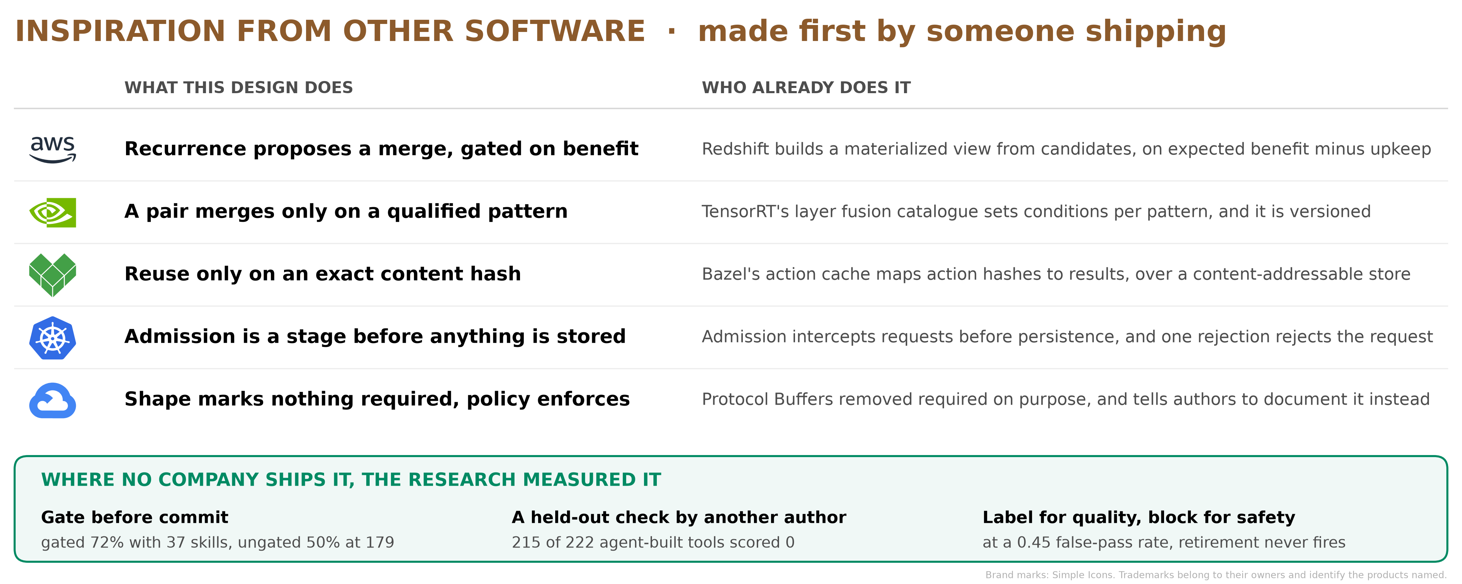
◆ E · SIMILAR DESIGNS
Inspiration from other software
↗ docs.nvidia.com layer fusion catalog
↗ bazel.build remote caching
↗ protobuf.dev never add a required field
Vendor documentation, read in full. None of it is AI software
19
Notes:
TIME 2:20
SAY: - Five decisions, five companies that made the same call first, in production, at a scale this research does not operate at
- Redshift builds a materialized view from candidates on expected benefit minus upkeep, and drops them when they stop being beneficial. That is our merge trigger, gated the same way
- TensorRT publishes a layer fusion catalogue with conditions per pattern, and versions it. Merging is not a general power there either
- Bazel reuses only on an exact content hash, over a content-addressable store, which is what the body hash and decl_hash are for
- Kubernetes admission intercepts a request before the resource is persisted and after it is authenticated, and one rejection rejects the whole request. Our gate is the same stage in the same place
- Protocol Buffers removed required on purpose and tells authors to document it instead, which is why the shape marks nothing required and a versioned policy epoch carries enforcement
- Where no company ships the thing, a study measured it. Gate before commit: gated 72 percent with 37 skills, against ungated 50 percent at 179. A held-out check by another author: 215 of 222 agent-built tools scored zero. Label for quality rather than block: at a 0.45 false-pass rate, retirement never fires
- If asked what is genuinely new: the schema and the records hung off it, and nothing else

Slide 20
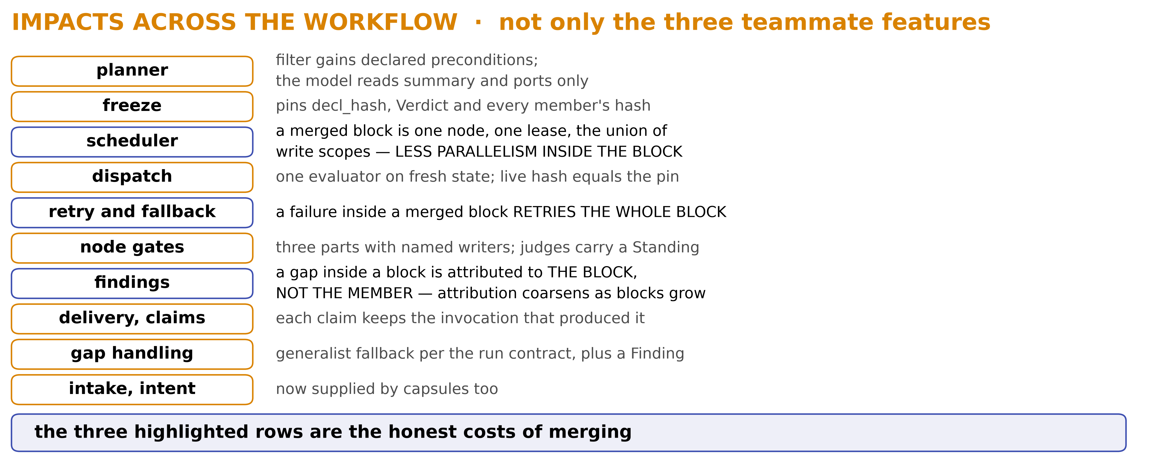
◆ D · DEPENDENCIES
Impacts across the workflow
Three costs are real: granularity, retry, attribution
AI4Research b0bf165f9, read in source
20
Notes:
TIME 1:30
SAY: - Not only the three teams, but the parts of the workflow that change shape
- The planner filter gains declared preconditions, and the model still reads only summary and ports
- The freeze pins decl_hash, the Verdict and every member hash
- Dispatch runs one evaluator on fresh state and checks the live hash against the pin
- Three of these are the honest costs of merging: a coarser placement grain, a whole-block retry when anything inside fails, and harder attribution
- Naming those first is why the rest is credible

Slide 21
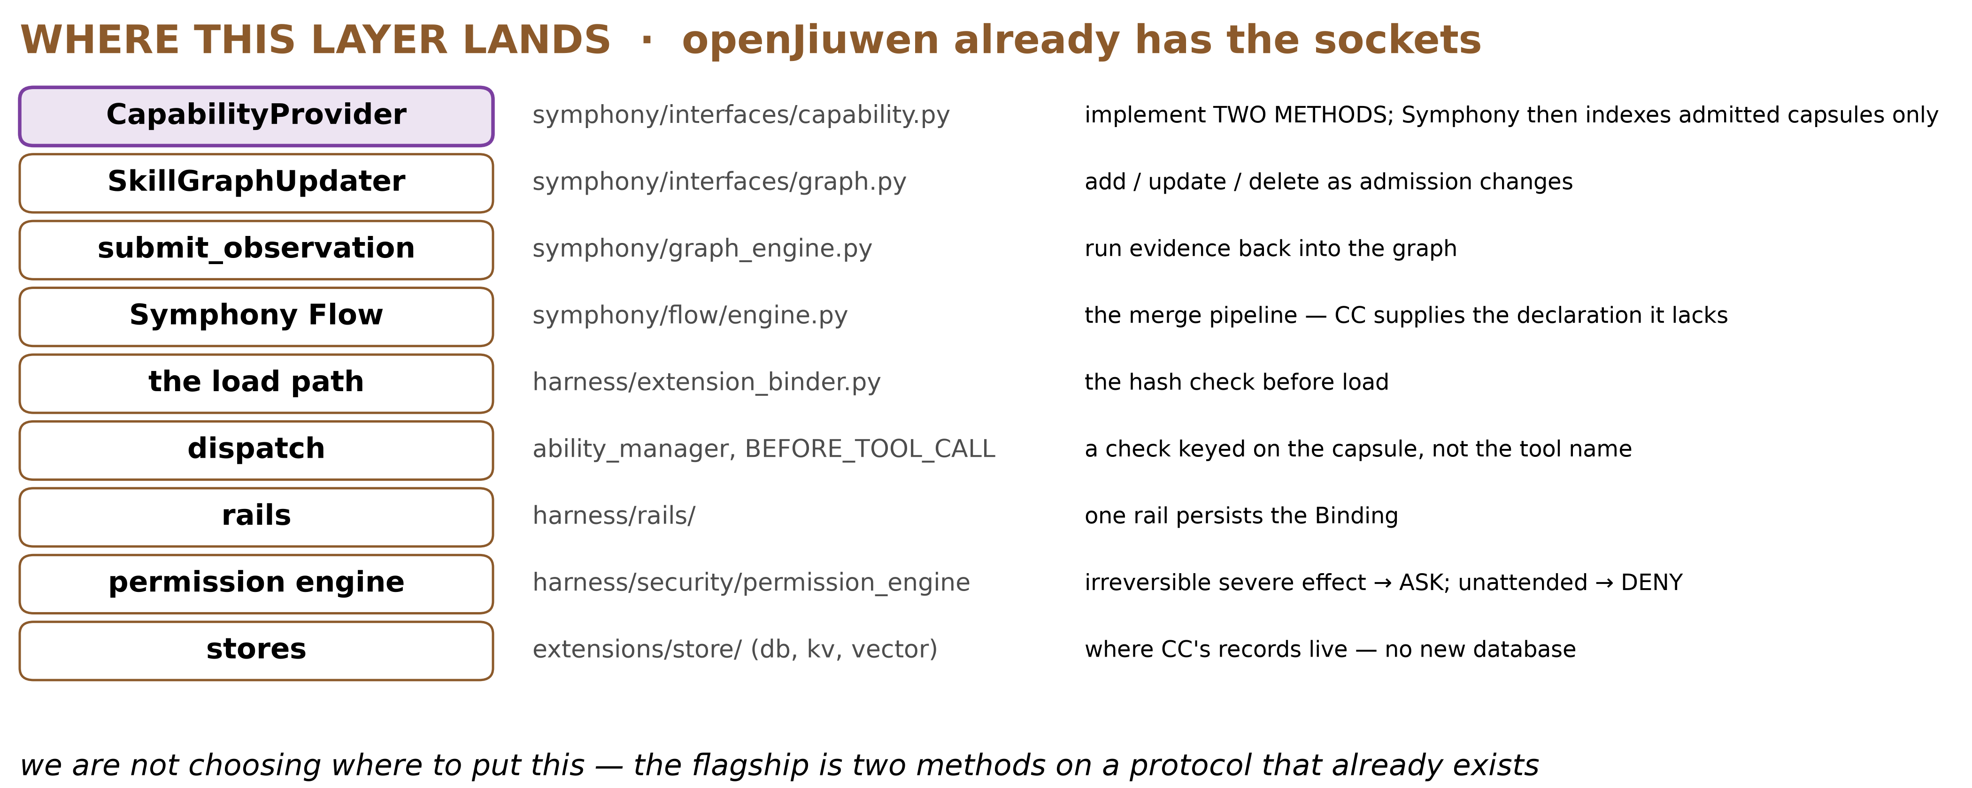
D · DEPENDENCIES
Where this layer lands in the code
Not a choice of where: openJiuwen already has the sockets
agent-core e23806c1, read in source. Locations illustrative
21
Notes:
TIME 1:20
SAY: - This is not a choice of where to put it. openJiuwen already has the sockets
- CapabilityProvider in symphony interfaces capability is the flagship: two methods, and Symphony then indexes admitted capsules only
- SkillGraphUpdater handles add, update and delete as admission changes
- submit_observation runs evidence back into the graph
- extension_binder loads the verified body through its carrier, and today it does so with no hash check, which is exactly the gap the body hash closes

Slide 22
F · ADVANTAGES
Picking and verifying
Study | What they did | What happened | So CC
More Skills, Worse Agents? | SkillsBench, two models, each task run inside libraries grown to 202 skills | pass rate down 0.21, 0.14 of it a look-alike skill chosen, context alone not significant. No-skill runs 12.0% to 38.5% | filter by code first, show only summary and ports, start small
Contract2Tool | a synthetic 100-tool registry, filtered by what each tool requires and produces | learned contracts 0.980 success at 2,528 tokens, correct ones 0.990, every tool shown 0.775 at 26,172 | correct contracts are what the filter needs. The importer proposes, a person confirms
Beyond Task Completion | agents built their own tools, then each ran on held-out tests of its claimed job | 215 of 222 scored 0. One passed its own tests, helped reach 0.95 task completion, then scored 0.00 | admission needs a check by another author, held out
CoEvoSkills | evolved skills with a verifier that never saw the source, giving diagnostic feedback | 71.1%, against 53.5% for human-curated skills. With only the oracle's pass or fail instead, 41.1% | a separate verifier gives practice feedback, only the sealed gate is pass or fail
More Skills, Worse Agents? (2605 Beyond Task Completion (2604
22
Notes:
TIME 1:40
SAY: - Bigger library: a look-alike skill wins, or none is used
- Context alone did not explain it
- Correct contracts filtered to one tool at a tenth of the tokens
- Learned contracts nearly matched: so the importer proposes, a person confirms
- Tools passed their tasks, so watching saw nothing
- Held-out tests by someone else: almost all failed
- CoEvoSkills: diagnostics from a verifier that never sees the source beat pass or fail alone
- Its ablation removes the feedback, it does not test separation. Do not claim it does

Slide 23
F · ADVANTAGES
Judging, growing and changing
Study | What they did | What happened | So CC
The Blind Curator | retired skills by judged contribution, with judges of known bias | at a 0.45 false-pass rate retirement can never fire. Real retirements fell from 1.3 to 0.3 there, 0.0 at the other rates, cap evictions hid it | judges earn a standing on planted defects
Cognitive Admission Control | a deterministic admission controller, 2,730 synthetic trials | 0 harmful effects in 390 trials, against 30 and 180. Without fetching missing evidence, 90 of 120 completed | typed verdicts, defer on unknown, no score
When Self-Evolution Backfires | grew a skill library over five rounds, with and without a gate before commit | ungated 62%, then 50% at 179 skills. Gated 72% with 37. Clean-up won back 1.7 of 12.3 points | gate before commit, lineage records what the builder saw
AllocBench | models decide whether to spend a build budget, from abstract to writing scripts | writing scripts, 3 of 4 built at first sight 85 to 99% of the time. Waiting scored 43.0 against 34.6 | code counts recurrence, then asks RSI to build (recommended there, untested)
SkillFuzz | searched 196 skills for benign sets that steer planners to goals nobody asked for | 1,188 found, 80.6% of the 98 riskiest confirmed. Severe drift 66.5% with five skills together | declared effects give the screener what it had to infer. Sets screened, never certified
Skill Drift | probed contracts on each skill's packages, URLs and APIs | 0 false alarms in 599 negatives, 76% recall. Repair given the failed contract: 25 of 32 | pinned by default, unpinned ones state their contracts
The Blind Curator (2607 When Self-Evolution Backfires (2608 SkillFuzz (2607
23
Notes:
TIME 1:40
SAY: - A lenient judge silently stops retirement, counts still look alive
- Measured risk with synthetic bias, their real judge was strict
- Unknown treated as yes lets harm in, as no loses completions
- So judges measured on planted defects, missing facts defer with a request
- Ungated library grew and got worse, gated stayed small and better
- Clean-up won back little: nobody recorded what builders saw
- Models with build tools build at first sight
- Separating decision from build is the paper's recommendation, untested
- SkillFuzz: harm only in combination
- It had to infer contracts from prose. CC supplies them. No claim declared beats inferred
- Sets are screened, never certified
- Skill Drift: contracts on dependencies, 0 false alarms, precise repair tickets

Slide 24



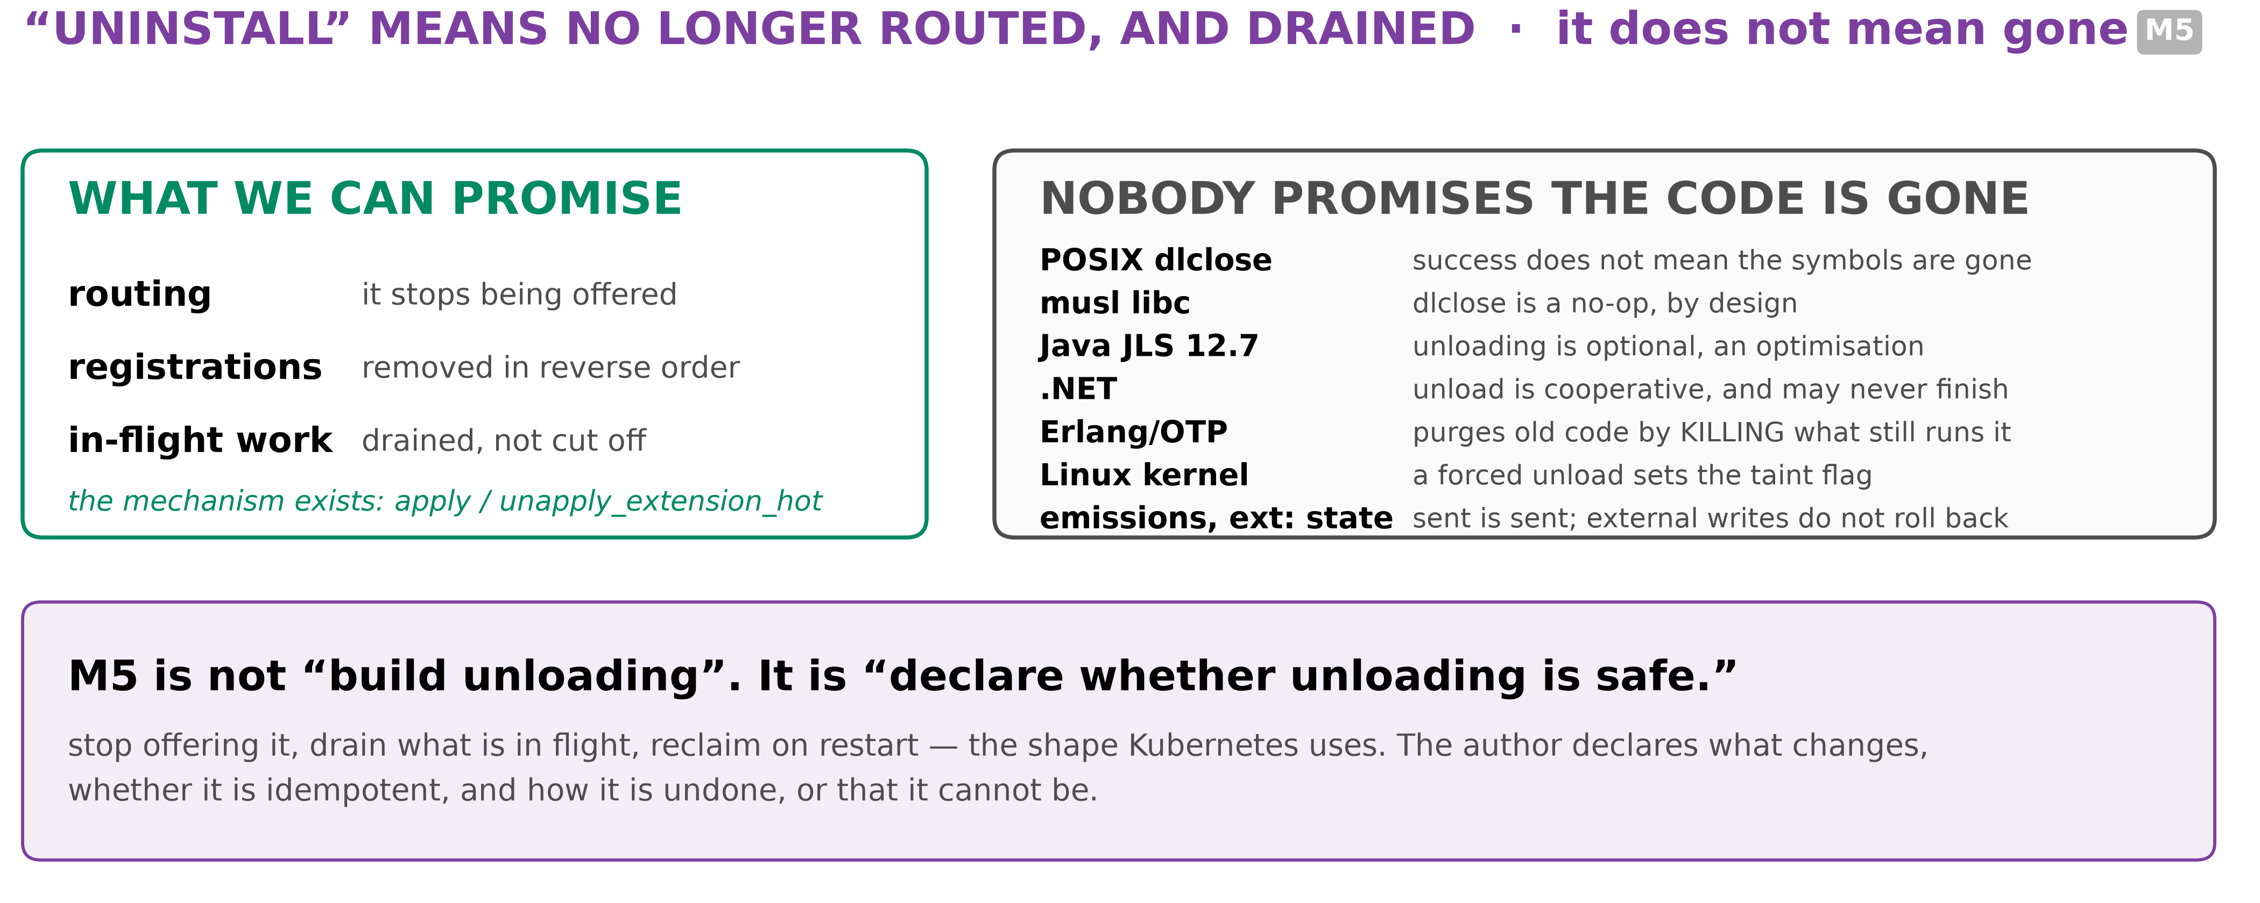
LIMITS
Install and uninstall mid-run
↗ wiki.musl-libc.org dlclose is a no-op
↗ erlang.org code loading
↗ learn.microsoft.com unload is cooperative
Cordis (2608.25512) p58-59, p70-71. agent-core extension_binder, read in source
24
Notes:
TIME 1:30
SAY: - Composability is last on the ladder because the platforms underneath do not promise what it needs
- musl documents that its loader keeps libraries for the life of the process and that dlclose is a no-op
- Erlang purges old code and terminates any process still lingering in it when a third instance loads
- .NET calls unloading cooperative, where calling Unload only initiates it
- The Linux manual page states that a successful return from dlclose does not guarantee the symbols are removed from the address space
- So the claim is bounded: registrations are undone in reverse and dependents are notified, within stated limits, and full reversibility is not claimed

Slide 25
LIMITS
What is not claimed, and what is held open
Not claimed | Held open
That a declared capsule is correct. What was checked is recorded, the rest is labelled | What cannot be a capsule at all. The boundary is known: a capsule may assess, never decide
Safety in combination. Sets are screened, never certified | Whether merging should later become fusion, which rewrites a block to run in one pass
Undoing emissions or external state, or cleaning a poisoned context | How the filter with declared preconditions compares with today's filter
That the design has been measured as a whole. Every number is from a paper's own setting | Who owns the shared predicate evaluator
merged/REPORT.md §14, §11
25
Notes:
TIME 1:20
SAY: - Held to what it offers, no more\n- The open questions are named on purpose, not left to be found\n- Fusion is the one that a compiler person will raise, so raise it first

Slide 26
◆ CLOSE
What would prove each of these wrong
The claim | Proved wrong if
A small, filtered library picks better | a small, filtered library picks worse than today's
A declaration gives every check a target | a certified capsule fails a held-out test of its job
Failing parts never need merging | a pair succeeds together while each member fails alone
Bigger blocks place better | merged blocks place no better than their members, at more cost
Composability is worth its complexity | unloading leaves the system in a state nobody can describe
merged/REPORT.md §11
26
Notes:
TIME 1:00
SAY: - Each claim is stated so it can be tested, and each has a way to fail
- The merge asymmetry is the one most worth attacking
- M1 is small on purpose: it is demonstrable now

